Slide 1
Canvas Gradebook
Getting Ready for the End of the Semester

Slide 2
Agenda
Gradebook Features
Arranging, Sorting, & Filtering
Color Coding
Creating Extra Columns
Grade Posting Policy
End of Semester Checklist
Grading Scheme
Assignment Groups vs. Adding Points
Downloading a copy of the gradebook
Submit grades to howdy
Student access after course conclusion

Slide 3
Objective
Successfully navigate and use Canvas Gradebook features in order to finalize grades.

Slide 4
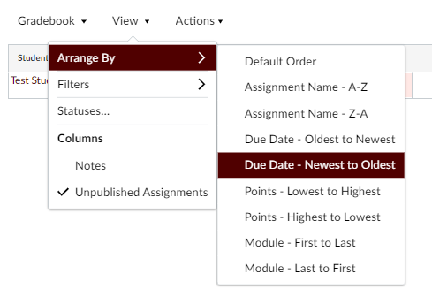
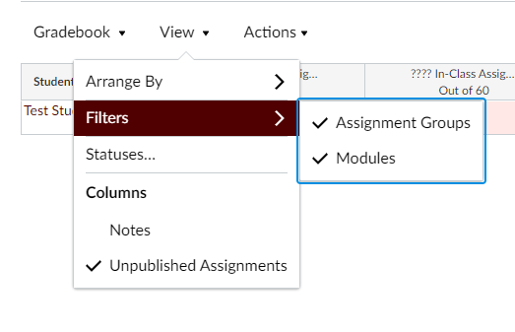
Quick Glance at Gradebook Features - Arranging & Filtering Columns
Drag and drop columns to reorder them horizontally, or use “Arrange By.”
Use filters in the “View” menu to show dropdown boxes at top of Gradebook, which helps to quickly find a grade column.

Slide 5
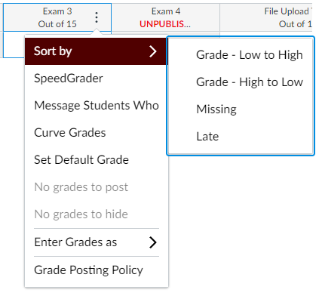
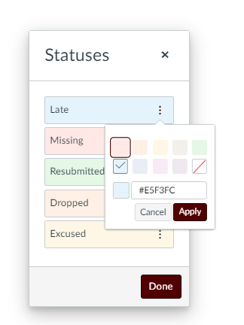
Quick Glance at Gradebook Features - Sorting, Color Coding
Click 3 dots in the column header to sort students grades within a column.
Go to View > Statuses to view or customize color coding of cells.

Slide 6
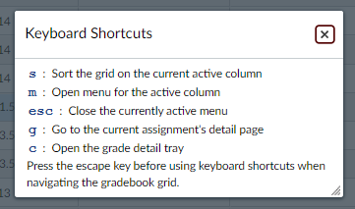
Gradebook Features - Search and Shortcuts

Slide 7
Gradebook Features - Creating Extra Columns
In Canvas, all Gradebook columns are associated with an assignment or quiz.
To create an extra gradebook column for a paper quiz, participation grade, or any other case where you need to manually enter grades, create an assignment and select “no submission” or “on paper.”

Slide 8
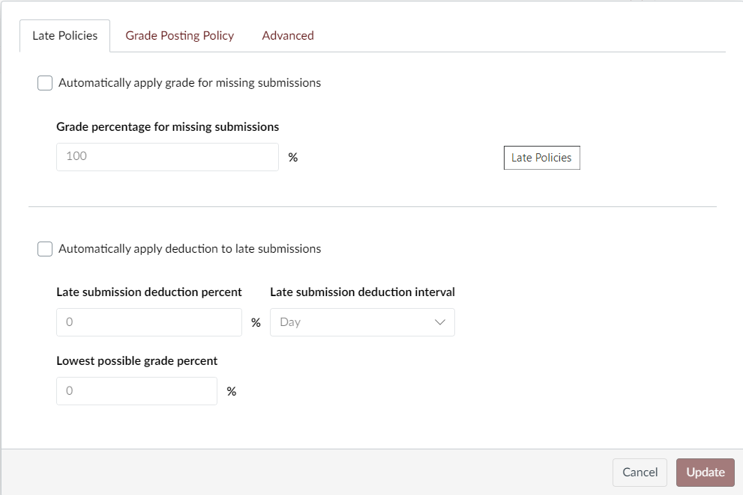
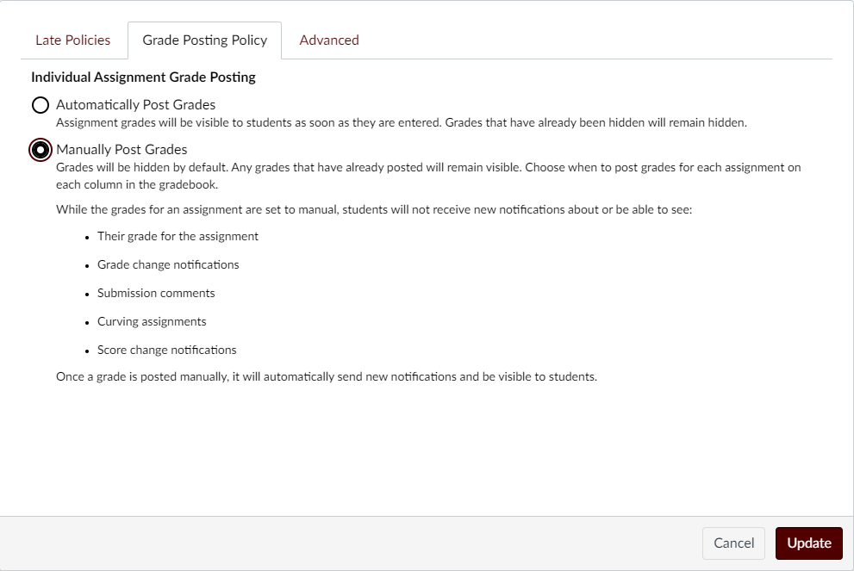
Grade Posting Policy

Slide 9
End of Semester Checklist
Review Grading Scheme and verify it matches syllabus.
If using assignment groups, groups are set up and each assignment is in the correct group.
All grades are entered, no grades are blank or missing.
All grades are posted and are visible to students.
Download a copy of your grades for your records.
Set up permissions to limit/allow student access to course after semester.
Submit grades to Howdy.

Slide 10
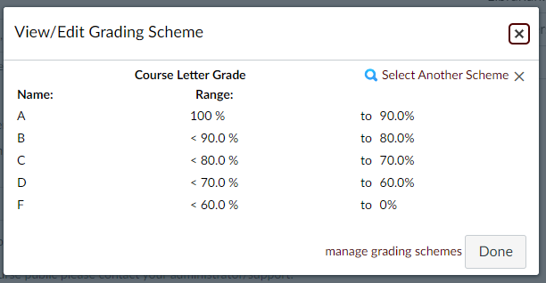
Grading Scheme
Keep in mind:
These percentages are not rounded. If a B+ is from exactly 87% to anything less than 90%, then a score of 86.9% would result in a B and a score of 90% would result in an A-
Settings > Course Details > Enable course grading scheme > View grading scheme

Slide 11
2 Options for Setting up Grade Calculations
Calculated total via Points
Assignments are weighted equally and a point is a point. This is the default in Canvas, and total scores will be calculated automatically.
Weighted total via Assignment Groups
All graded assignments are organized into assignment groups, and a weighted percentage is assigned to each group.

Slide 12
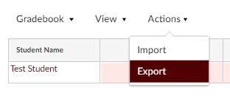
Downloading a CSV of the Gradebook
After you have reviewed and entered all of your grades, we recommend exporting your gradebook to review the column that will be sent to Howdy from Canvas. Review the Unposted Current Grade column for Midterm Grade Submission and Unposted Final Grade for Final Grade Submission.

Slide 13
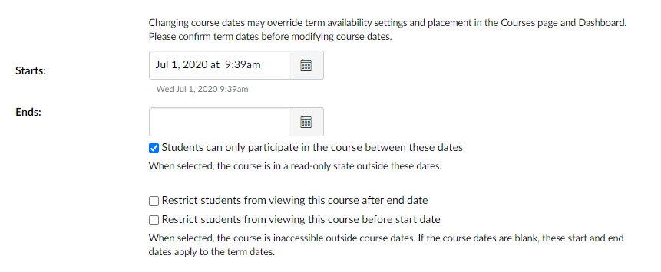
Concluding your Course

Slide 14
Submit Grades to Howdy
In Howdy, click the Faculty/Teaching tab.
On the Faculty/Teaching tab, in the Instructor Class Management or Associate Self Service section, click Class Roster and Syllabus, locate the course, and then click View.
To proceed to grade submission, click the Enter link in any student’s Midterm/Final column. If there are existing grades, click the grade instead.
To import grades, click the Import Midterm/Final Grades from Canvas button. Wait until the process is complete and moves to the status page.
Review the import errors and confirm grades appear successfully. This process will override grades each time that it is run, even manual updates.
After the process is complete, users can manually add or change grades if needed before submitting.
More Information on lms.tamu.edu

Slide 15
End of Semester Checklist 2
Review Grading Scheme and verify it matches syllabus.
If using assignment groups, groups are set up and each assignment is in the correct group.
All grades are entered, no grades are blank or missing.
All grades are posted and are visible to students.
Download a copy of your grades for your records.
Set up permissions to limit/allow student access to course after semester.
Submit grades to Howdy.

Slide 16
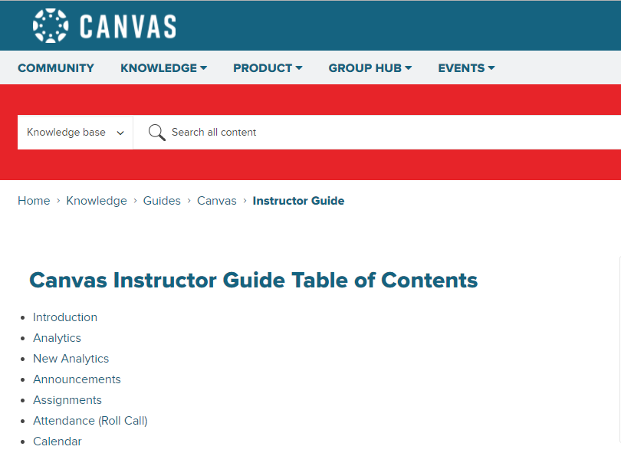
Resources
Check the
Instructor Guide
or search in
Community!
Notes:
Canvas has several great resources which offer so much support and training information. There is the Instructor Guide, which is quite comprehensive, and the Canvas Community. Canvas Community is a very active forum, and I think I visit it for answers to tricky questions at least once or twice a week.

Slide 17
Q&A

